Slide 1
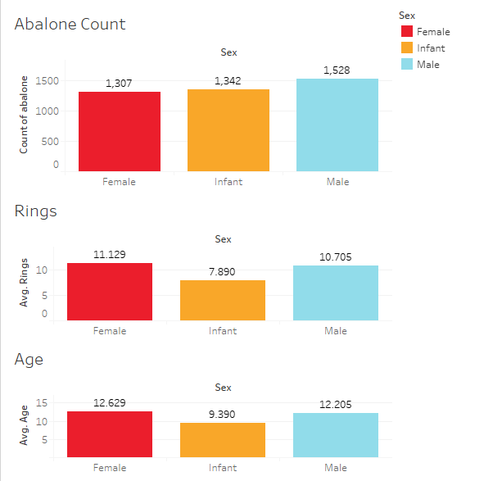
Descriptive Analytics
Average height
length and diameter of
each sex.

Slide 2
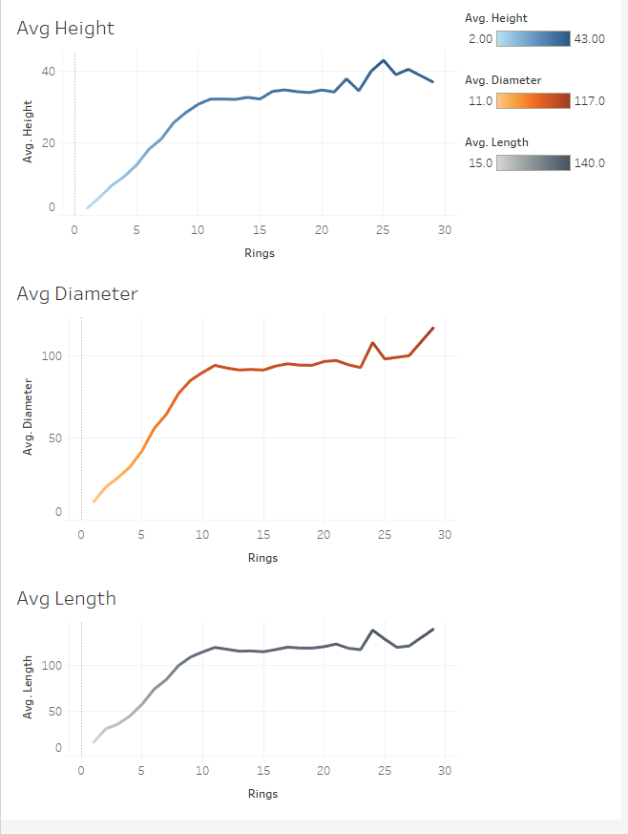
Descriptive Analytics
Average height,
diameter and length
based on number of
rings

Slide 3
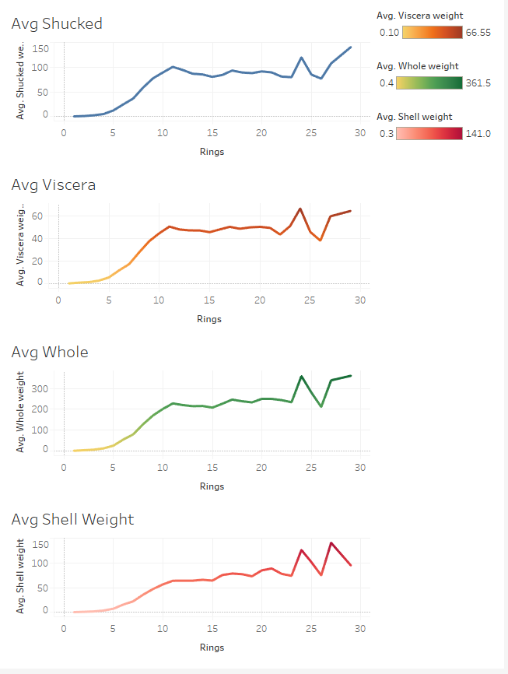
Descriptive Analytics
Average weights based
on rings

Slide 4
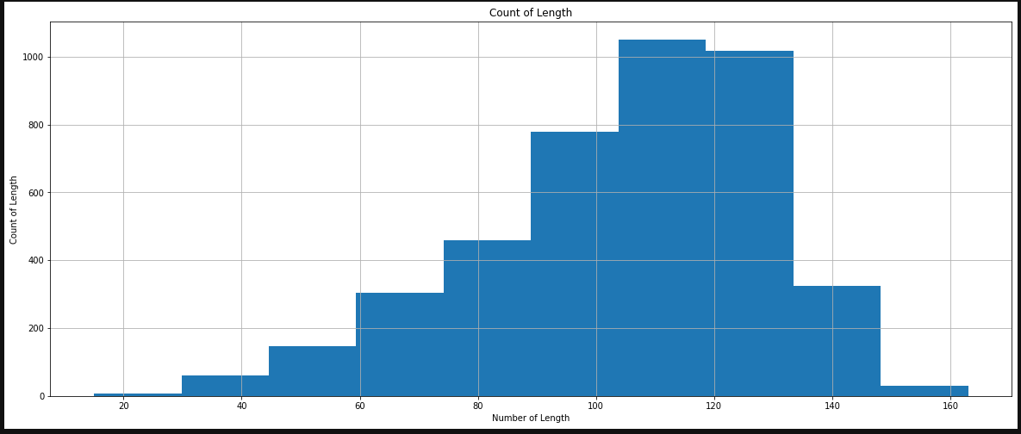
Descriptive Analytics

Slide 5
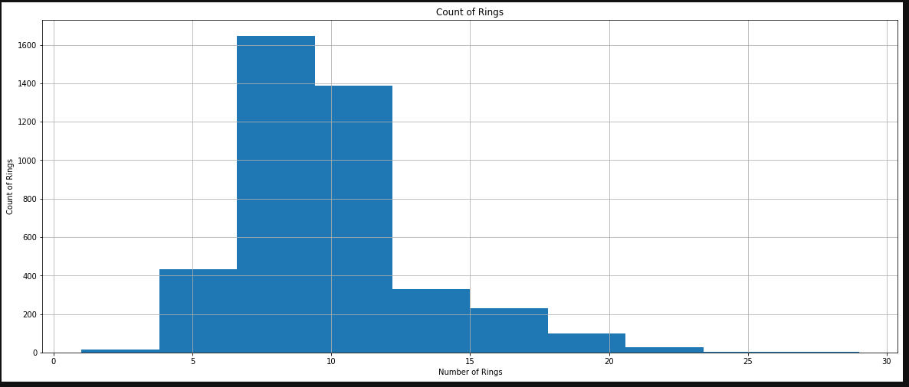
Descriptive Analytics
Slide text

Slide 6
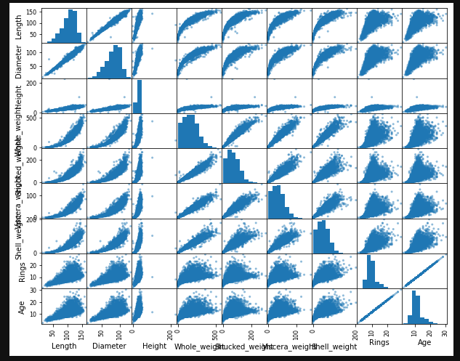
Descriptive Analytics

